Slide 1

Modern Big Data Analysis with SQL
-Yarragunta Sai Charan Reddy

Slide 2
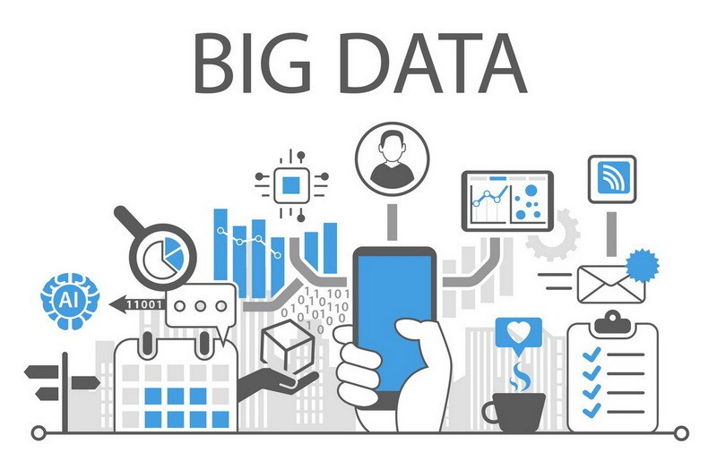
What is Big data?
Big data is a collection of massive and complex data sets and data volume that include the huge quantities of data.
It can be say that extremely large data sets that can be analysed computationally to reveal patterns, graph trends etc.
Big data generates value from the storage and processing of large quantities of digital information that cannot be analysed with traditional computer techniques.
Big data is about data volume and large data set's measured in terms of terabytes or petabytes.
Like many new information technologies big data can bring about huge cost reductions, substantial improvements in time required to perform computer tasks or new product and service offerings.

Slide 3
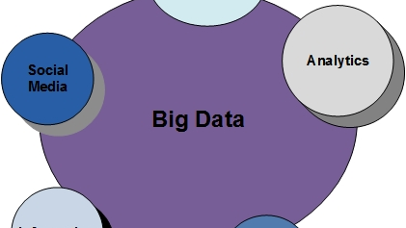
Why is Big data?
With this technology any organisation or individual can obtain, store, transform, analyse large amount of data to solve specific problems.
One can build predictive data models and detect future trends. Devices of future will be built entirely on big data.
You can take data from any source and analyse it to find answers that enable
1) cost reductions
2) time reductions
3) new product development and optimized offerings.
4) smart decision making

Slide 4
Why is Big data?
Big data helps to take decision based on some pattern and model.
For example: using of big data in an organisation is to inform new product developments.
1.Organisations can develop products that connect with the consumer.
2.It provide increased consumer value and minimize the risks associated with a new products launch.
3.It provides valuable insights into customers that companies can use to refine their marketing, advertising and promotions in order to increase customer engagement and conversion rates.

Slide 5
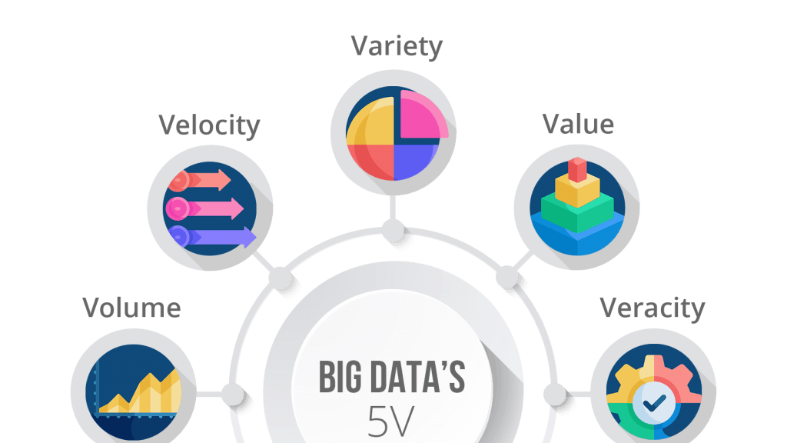
Big data working concept
Big data works in the principle of 5v’s
Volume refers to the amount of data that is being collected. The data could be structured or unstructured.
Velocity refers to the rate at which data is coming in. the speed of generation of data. How fast the data is generated and processed to meet the demands, determines real potential in the data.
Variety refers to the different kinds of data (data types, formats, etc.) that is coming in for analysis. Data in the form of emails, photos, videos, monitoring devices, PDFs, audio, etc. are also being considered in the analysis applications.
Veracity refers to the quality of data that is coming in from different sources. data in the form of emails, photos, videos, monitoring devices, PDFs, audio, etc.
Value refers to the usefulness of the collected data.

Slide 6
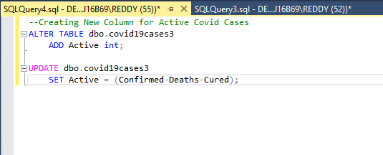
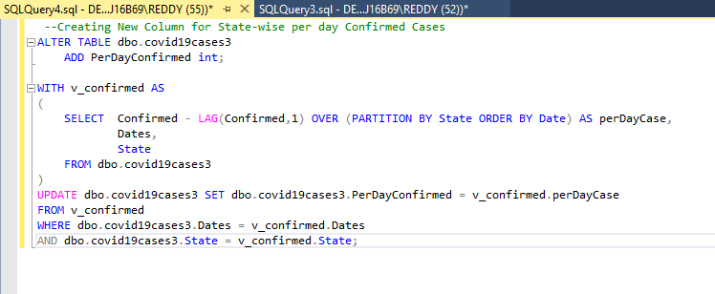
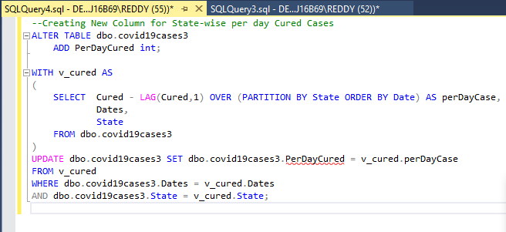
Project
Firstly I collected covid19 dataset from internet uploaded dataset into Microsoft SQL and from there I altered the tables using commands for creating new columns for per day cured cases, per day confirmed, per day deaths.

Slide 7
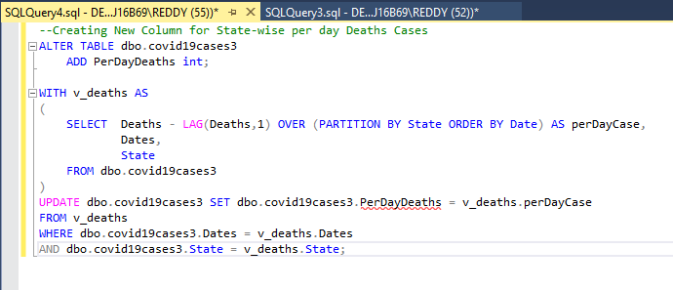
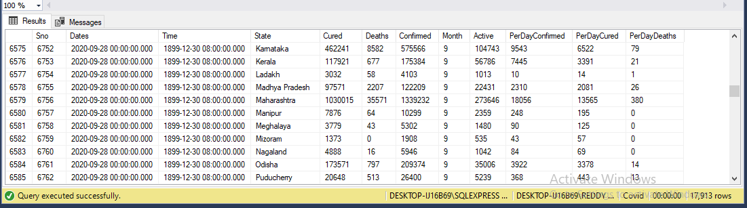

Slide 8
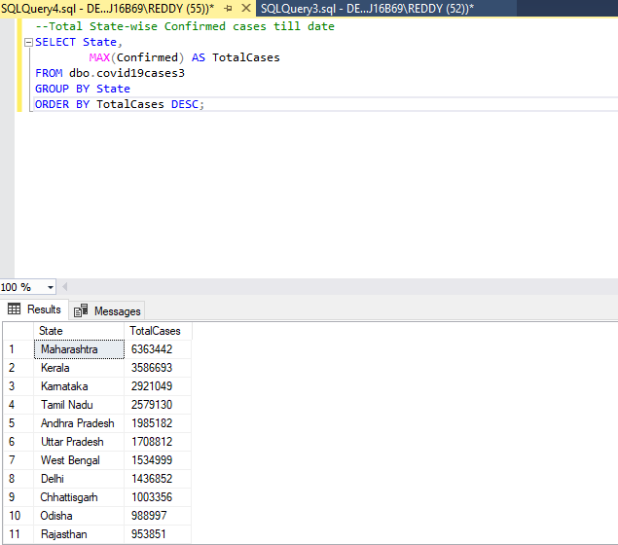
Query for total state wise confirmed cases till date

Slide 9
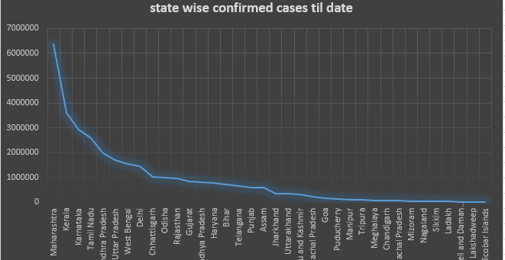

Slide 10
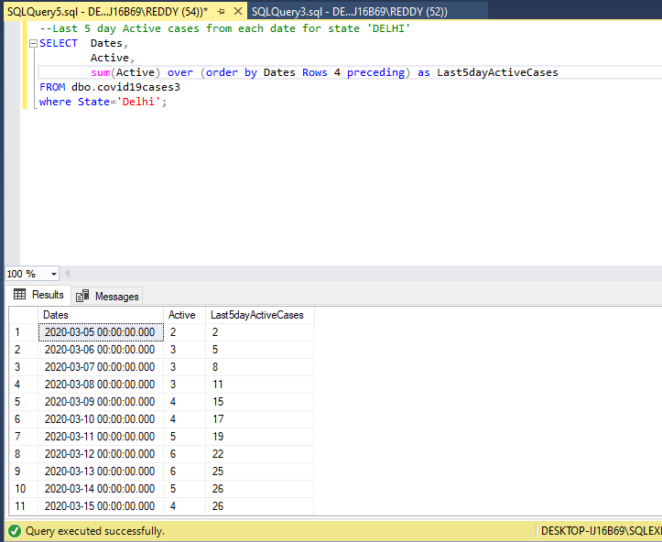
Query for cases in Delhi in last 5 days.

Slide 11
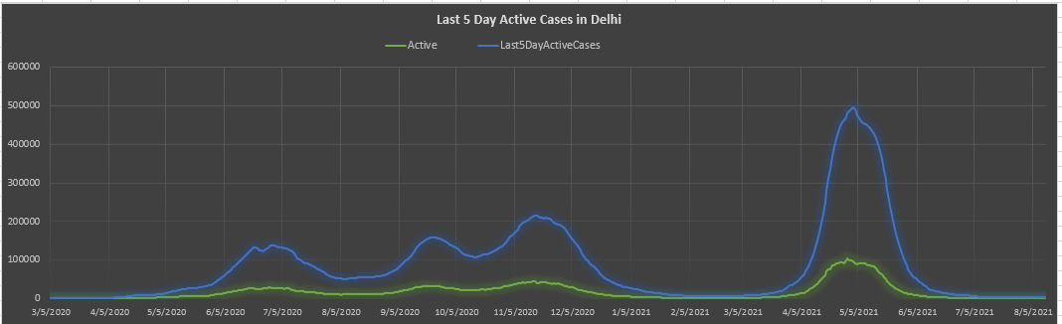

Slide 12
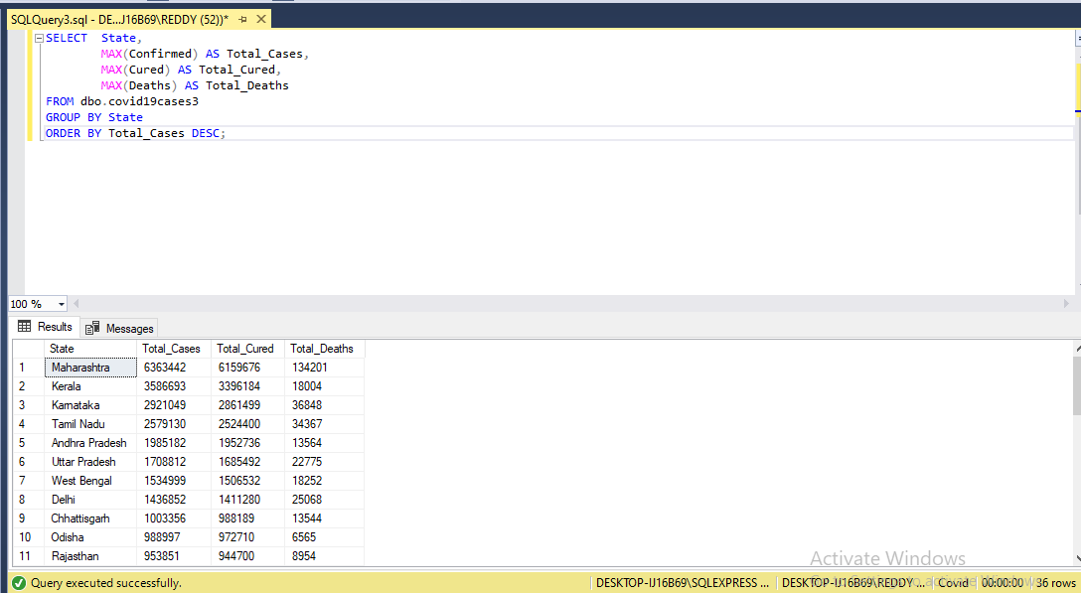
Total cases, total deaths and total cured in each state.

Slide 13
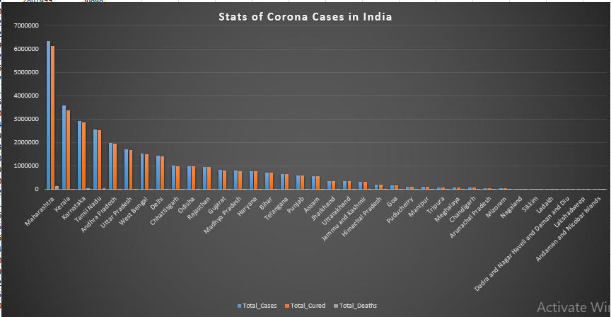

Slide 14
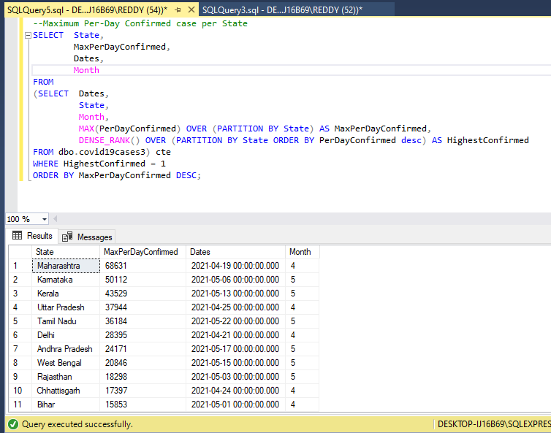
Maximum per day confirmed cases per state

Slide 15
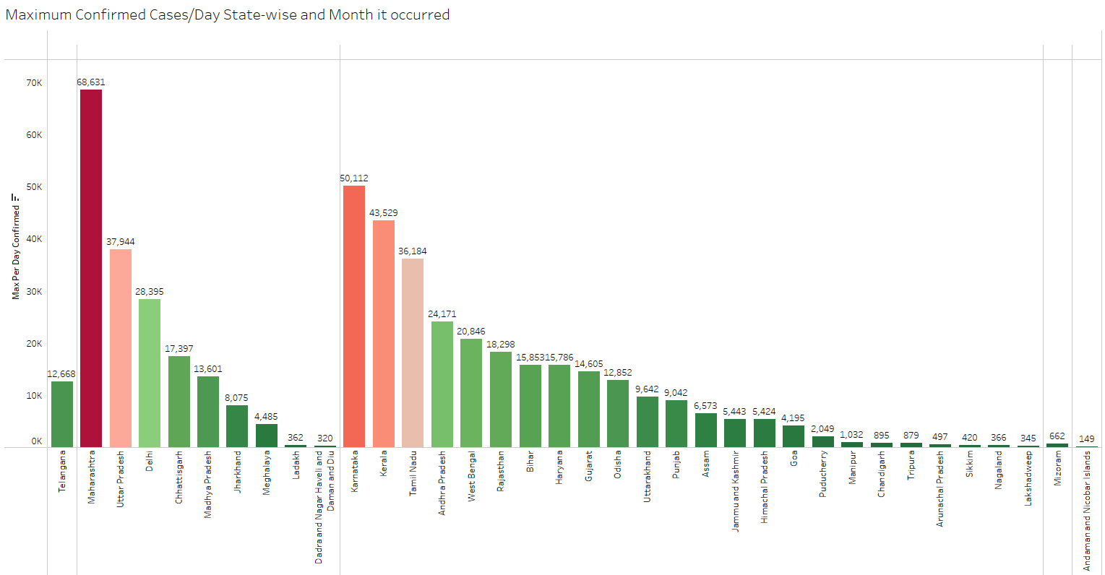

Slide 16
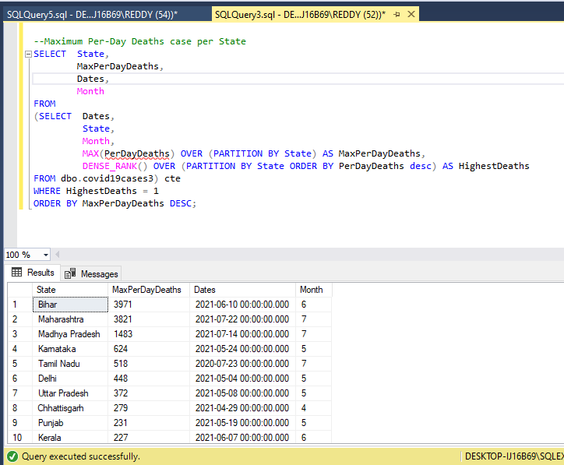
Query for Maximum per day deaths case in state

Slide 17
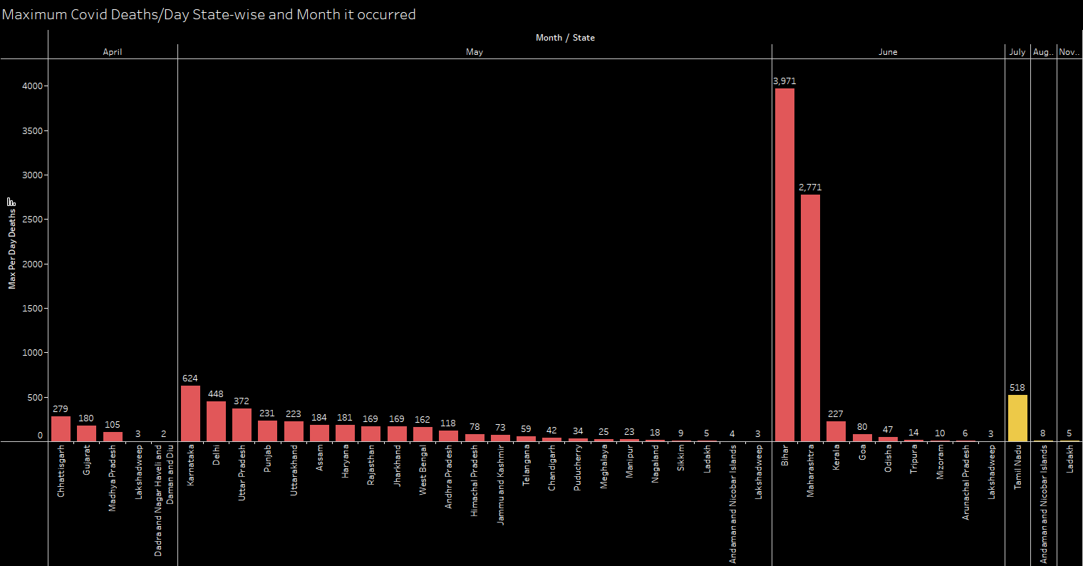

Slide 18
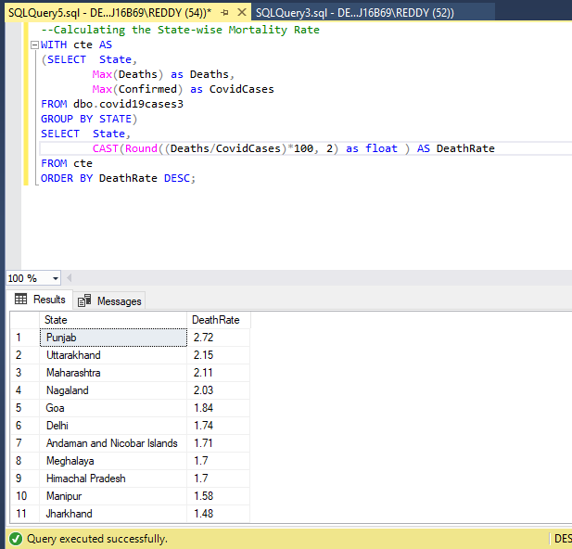
Query for calculating the state wise mortality rate in India

Slide 19
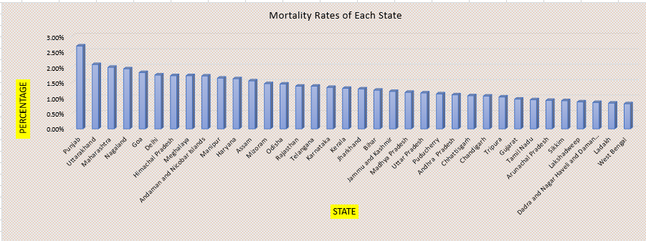

Slide 20
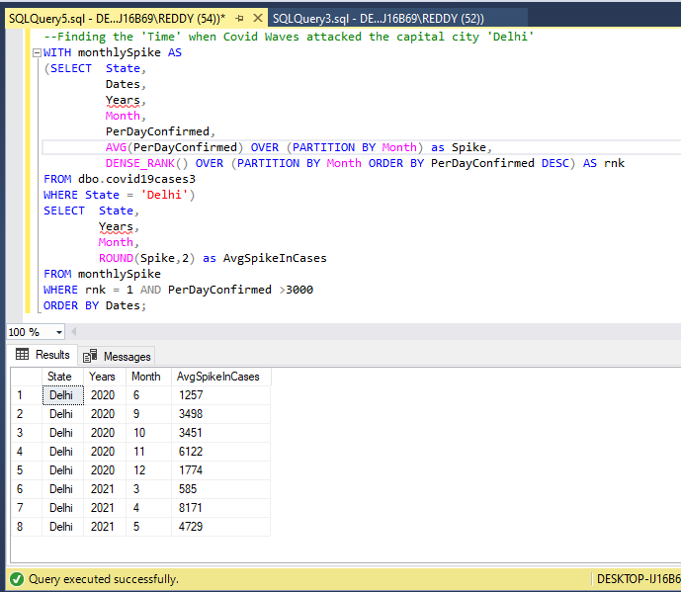
Query for finding covid waves in india

Slide 21
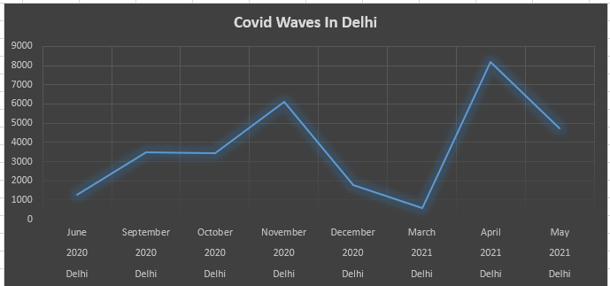

Slide 22
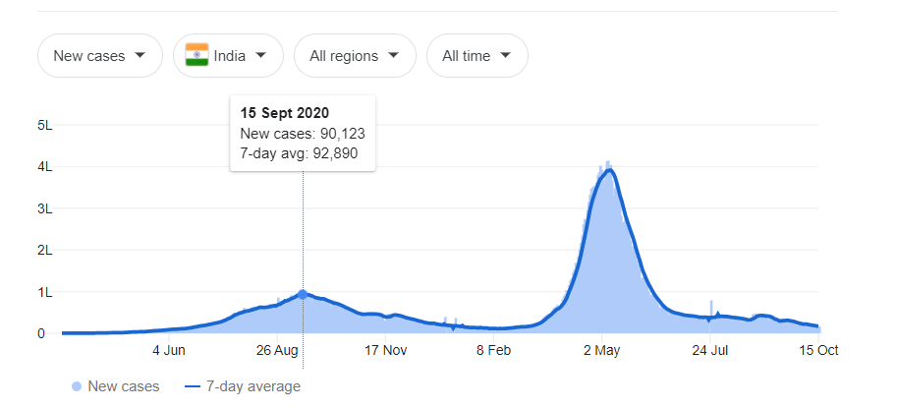
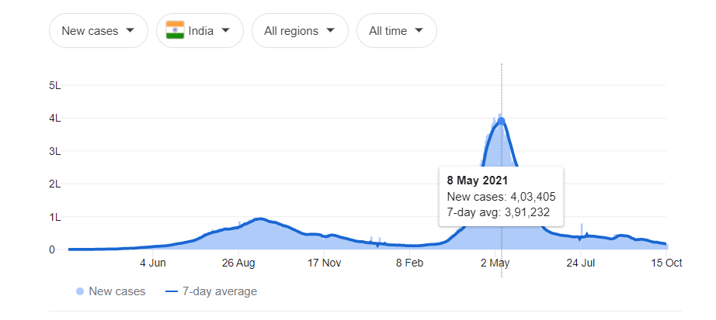
This is how the analytics calculated the future trends of corona cases.

Slide 23
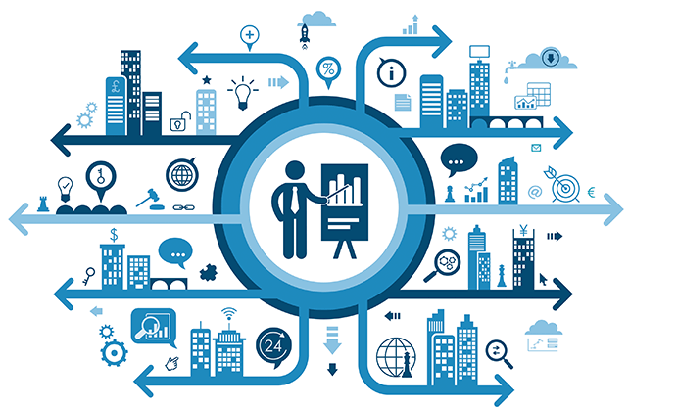
Advantages of Big data
Big data provides many advantages.
Risk Management
Quicker and better decision making within Organisation
Improve Customer Experience
Using big data we can do cost reductions
Time reductions. Easy possible way to search solutions.
In business. One can compete with big businesses.
Easily predict future market trends.
Using of big data can increase science and research.
Smart recommendations and targeting’s.

Slide 24
Examples of Big data in real life
1.The New York Stock Exchange is an example of Big Data that generates about one terabyte of new trade data per day.
2.The statistic shows that 500+terabytes of new data get ingested into the databases of social media site Facebook, every day. This data is mainly generated in terms of photo and video uploads, message exchanges, putting comments etc.
A single Jet engine can generate 10+terabytes of data in 30 minutes of flight time. With many thousand flights per day, generation of data reaches up too many Petabytes.
The biggest online platform for streaming movies Netflix says that their success owns to big data. By giving recommendations in library to customers what they watch more.
Manufacturers and transportation companies rely on big data to manage their supply chains and optimize delivery routes.
Financial services use big data systems for risk management and real time analysis of market data.
Other government uses include emergency response, crime prevention and smart city initiatives.

Slide 25

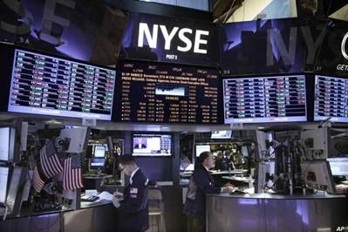


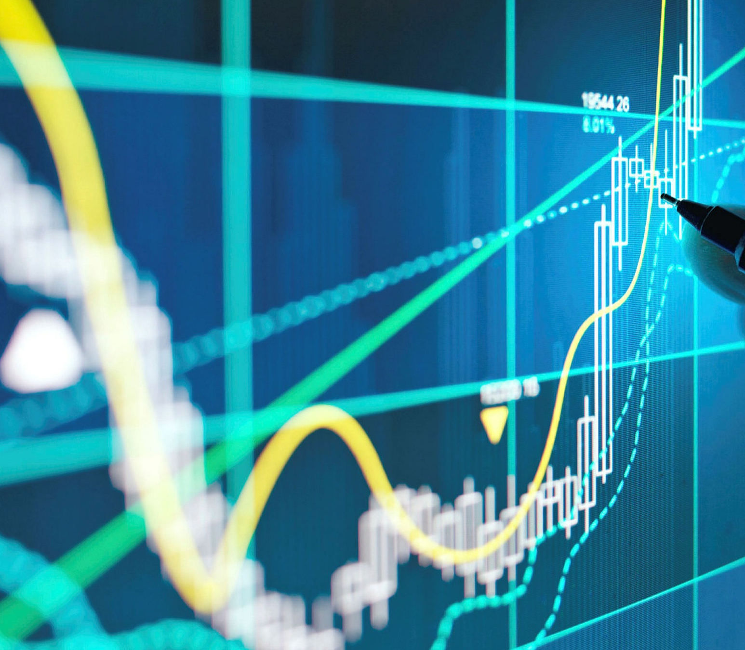


Slide 26
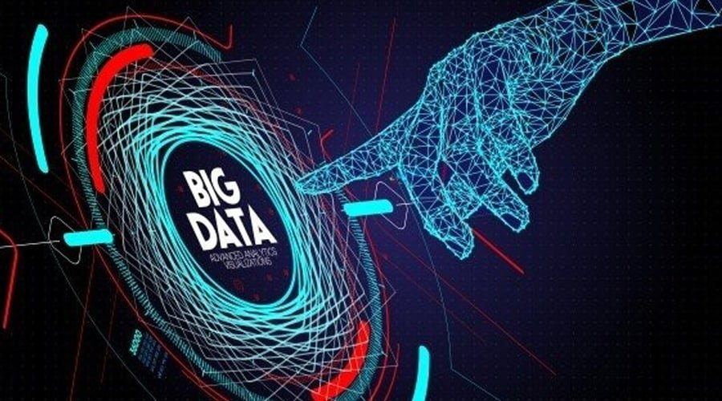
Learning Outcomes
I learned a lot from this project.
I learned what is big data and how big data is useful in life.
I learned how big data works in many big tech companies.
I learned how big data managed to see the future market trends.
I learned where big data is using most and how much data they are handling using big data.
How organisations develop their products based on consumer value.
How big data is used in organisations for risk free management.
I also learned how these increasing/ decreasing in graph trends works. Ex.covid-19 cases.

Slide 27
Thank you🙂

